Slide 1
Day - 1
By: Ujjwal Verma
www.linkedin.com/in/ujjwalverma1411
https://github.com/UjjwalVerma1411/python-learning-journey/tree/main/Week1/Day1

Slide 2
Coding n Programming
What is programming – Giving computer a sequence of instruction to solve a problem.
For eg: Calculate the sum of 2 numbers.
>Human Solution: Take first number > Take second number > Add them > Show result
>Programming is simply writing those instruction in a language that computer understands.
Coding | Programming
Writing instructions in a programming language. | Creating a complete software solution.
Translating logic into specific syntax. | Problem-solving, algorithms, and overall system architecture.
Focuses on syntax and implementation. | Includes planning, design, coding, testing, debugging, and maintenance.
A subset of programming. | A broader process that includes coding.
Writing scripts, fixing syntax errors (debugging), and implementing smaller pieces of functionality. | Brainstorming, planning algorithms, testing for bugs, evaluating performance, and maintaining the software's life cycle.
Example: Writing a Python function to sort a list. | Example: Building a complete inventory management application.

Slide 3
IDE
Integrated Development Environment (IDE) - programmer's workspace where multiple tools are combined into one application.
With an IDE:
Everything is integrated:
Code Editor
Terminal
Debugger
File Explorer
Extensions
Without an IDE:
You would need:
Text Editor → Write code
Terminal → Run code
Debugger → Find bugs
File Manager → Manage files
Eg of IDE:
Beginner Friendly
IDLE (comes with Python) - It is an integrated development environment for Python.
Thonny - It is a free and open-source integrated development environment for Python that is designed for beginners.
Professional
PyCharm
Visual Studio - Technically VS Code is a code editor, but after installing extensions (like the Python extension), it behaves very much like an IDE.

Slide 4
Text Editor
It is simply a program used to write and edit plain text files.
For programming, a text editor is where you write your code.
Eg:
Very Basic
Notepad (Windows)
TextEdit (Mac)
Code Editors (Advanced Text Editors)
VS Code
Sublime Text
Notepad++
Vim
These are designed for programmers.
They provide:
Syntax highlighting
Auto-completion
Line numbers
Search and replace
File management
Text Editor | IDE
Used mainly to write and edit code | Used to write, run, debug, and manage code

Slide 5
Path
1
PATH is a system variable that tells Windows:
"Where should I look when the user types a command in the terminal?"
For example, when you type: python
Windows has to find where python.exe is installed.
It searches the folders listed in PATH.
Without "Add Python to PATH“
Suppose Python is installed here:
C:\Users\Ujjwal\AppData\Local\Programs\Python\Python313\
If this folder is not in PATH, then:
Python will give an error like:
'python' is not recognized as an internal or external command
because Windows doesn't know where Python is.
With "Add Python to PATH“
The installer adds Python's folder to PATH.
Now when you type: “python”
Windows checks PATH, finds:
C:\Users\Ujjwal\AppData\Local\Programs\Python\Python313\
and runs:
python.exe
automatically.

Slide 6
Path
2
Simple Analogy
Imagine you want a book from a library
Without PATH
You must give the exact address:
Go to Building A Floor 3 Shelf 12 Book Python
With PATH
You simply say:
Bring Python book
because the librarian already knows where to look.
PATH is that list of known locations.
"Add Python to PATH" tells Windows where Python is installed so that commands like python and pip can be run from any terminal.

Slide 7
Terminal
Terminal is the program which let’s us communicate with the operating system by using commands.
Instead of clicking buttons and icons, you type instructions.
GUI (Graphical User Interface)
You communicate by clicking:
Click Folder ↓ Click File ↓ Open Program
Terminal
You communicate directly:
Open Program
The terminal is often faster and more powerful.

Slide 8
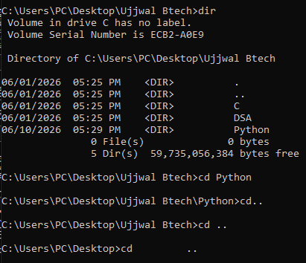
Common Terminal Commands Windows
Show files in current folder
dir
Change folder
Cd – Change Directory
cd __
Folder name
Go back one folder
cd ..
cd..
cd ..
Clear screen
cls

Slide 9
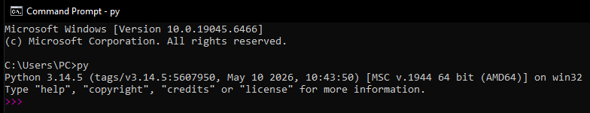
Some Python Terminal Command
In Terminal type to check which version of python is installed:
py --version
python --version
python3 --verison
In Terminal type – py, python, py3 – to enter python prompt mode
The place where you can type Python commands directly and get immediate results. We can execute Python code one line at a time.
This is called Python Prompt
In Terminal type – exit(), quit(), Ctrl +z then Enter – to exit python prompt mode

Slide 10
Python Prompt n Python File
Python Prompt | Python File
Temporary | Saved
One command at a time | Full programs
Testing | Actual development
>>> appears | No >>>

Slide 11
Argument
An argument is the value you give to a function when you call it.
print("Hello")
"Hello"
is the argument.
Print(10)
10
is the argument.

Slide 12
Statement
A statement is a complete instruction given to Python.
Think:
A statement tells Python to do something.
print("Hello")
This is a statement.
Meaning:
Display Hello
x = 10
This is a statement.
Meaning:
Store 10 in x
print(x)
Another statement.
Meaning:
Display value of x

Slide 13
Expression
An expression is anything that Python can evaluate to produce a value.
Think:
Expression = Something that gives a result/value.
5 + 3
Python evaluates it:
8
So 5 + 3 is an expression.
10
Value:
10
This is also an expression.
"Hello"
Value:
Hello
(String value)
This is also an expression.
Expression
Produces a value.
Statement
Performs an action.

Slide 14
Print Function

Slide 15
Hello World
print
A built-in Python function.
Its job is:
Display something on the screen.
"Hello World"
A string (text data).
The quotes tell Python:
Treat this as text.
What happens internally
Python reads print(...)
↓
Finds text inside quotes
↓
Displays it on screen

Slide 16
Flow of print
1
print("Hello") ↓ Python sees print() ↓ Calls the built-in print function ↓ Evaluates the arguments ↓ "Hello" is obtained as a string object ↓ Converts object to displayable text ↓ Sends text to standard output (stdout) ↓ Terminal receives the text ↓ Terminal displays: Hello ↓ print() sends newline (\n) by default ↓ Cursor moves to next line
print(True)
↓
Python sees print()
↓
Evaluates argument
↓
True is already a Boolean object
↓
Calls print(True)
↓
Converts Boolean object to text
↓
"True"
↓
Sends "True" to stdout
↓
Terminal displays:
True
↓
Adds newline (\n)
print(5 + 3)
↓
Evaluate expression
↓
5 + 3 = 8
↓
Call print(8)
↓
Convert 8 to text "8"
↓
Send to stdout
↓
Terminal displays 8
↓
Add newline

Slide 17
Flow of print
2
print(10)
↓
Python sees print()
↓
Evaluates argument
↓
10 is already an integer object
↓
Calls print(10)
↓
Converts integer object to text
↓
"10"
↓
Sends "10" to stdout
↓
Terminal displays:
10
↓
Adds newline (\n)
print() does not change the data; it simply shows a readable text version of the data on the screen i.e via string.
General Rule
Your Code ↓ Python Interpreter ↓ Built-in print() Function ↓ stdout (standard output stream) ↓ Terminal / Console ↓ Screen
Evaluate value ↓ Get Python object ↓ Convert object to text representation ↓ Send text to stdout ↓ Terminal displays it ↓ Add newline

Slide 18
Multiple Arguments
We can print multiple argument with one print statement

Slide 19


Point to remember about print
1
Python automatically prints another print statement in a new line
If we want them on the same line?
Use the end parameter:
end controls what gets printed after the output of a print() statement.
By default, it is a newline (\n).

Slide 20

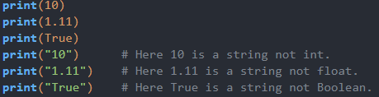
Point to remember about print
2
Why we don’t require quotes while printing int/float or other data type
The answer is that quotes tell Python that something is text (a string).

Slide 21
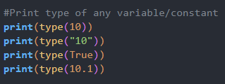

Point to remember about print
3
Printing Type of a Variable/Constant

Slide 22
Possible Error in Print
Traceback
When a program contains a significant error, Python displays a traceback, which is an error report.
A traceback is Python's report explaining:
Where an error happened.
What error happened.
Sometimes why it happened.
Think of it as Python's error investigation report.
Example: print(10 / 0)
Output:
Traceback (most recent call last): File "test.py", line 1, in <module> print(10 / 0) ZeroDivisionError: division by zero
This entire message is called the traceback.

Slide 23

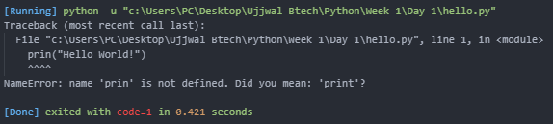
Possible Error in Print
1
NameError
Wrong print spelling

Slide 24

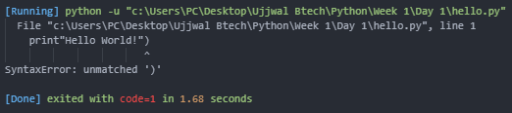
Possible Error in Print
2
Syntax Error
No bracket Open

Slide 25

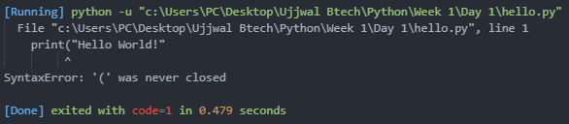
Possible Error in Print
3
Syntax Error
No bracket Close

Slide 26
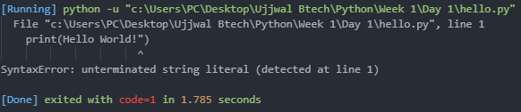
Possible Error in Print
4
Syntax Error
No entry quotes

Slide 27

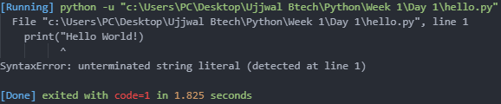
Possible Error in Print
5
Syntax Error
No end quotes

Slide 28
Possible Error in Print
6
Grammatical Error
NO error

Slide 29
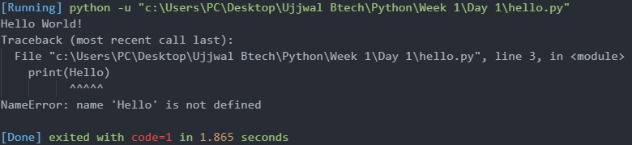
Possible Error in Print
7
NameError : name “Hello” is not defined
Here ‘Hello’ is treated as variable and hello is not defined in the file.

Slide 30
Comments

Slide 31

Comments
Comments are notes written for humans.
Python ignores them when running a program(execution).
Single line comment - #
Eg: print(“Hello”) #Display Hello

Slide 32

Multi line Comment
3 Single Quotes‘’’’’’; 3Double Quotes“”””””
Technically, Python does not have a true multi-line comment syntax like C or Java.
or
These are actually multi-line strings, not comments.
Python creates a string object and then immediately discards it because it's not assigned to a variable.
So, it behaves like a comment, but it isn't one.
Special Use: Docstrings
Later in the book (Functions and Classes), you'll see:
Here the triple quotes are called a docstring, which documents the function.
""" This is a multi-line comment """
''' This is a multi-line comment '''

